Slide 1


Feedback in Writing Process
Session IV: Groups & Teams (In) Action

Slide 2

Chapter outlines
Diverse Forms of Feedback
Feedback as an Opportunity

Slide 3
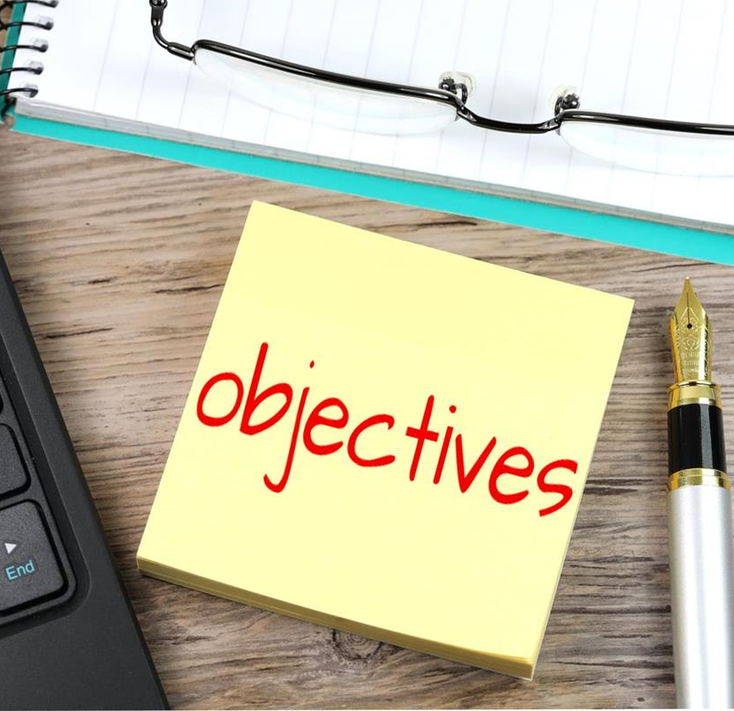
LEARNING OBJECTIVES
By the end of this section, you will be able to:
1. Describe feedback as part of the writing process.
2. Compare and contrast indirect and direct feedback.
3. Understand internal and external feedback.
4. Discuss diverse forms of feedback.
5. Describe the five types of feedback identified by Carl Rogers.

Slide 4
Criticism may not be agreeable, but it is necessary. It fulfills the same function as pain in the human body. It calls attention to an unhealthy state of things.
(Winston Churchil)

Slide 5
Any fool can criticize, condemn, and complain but it takes character and self control to be understanding and forgiving.
Dale Carnegie

Slide 6

1. Diverse Forms of Feedback
Feedback is defined as a receiver’s response to a source, and can come in many forms. Feedback can be both verbal and nonverbal, and it may involve signs, symbols, words, or sounds that are unclear or difficult to understand.

Slide 7

Indirect Feedback
& Direct Feedback
Indirect feedback is a response that does not directly come from the receiver or source
Direct feedback is a response that comes from the receiver.

Slide 8
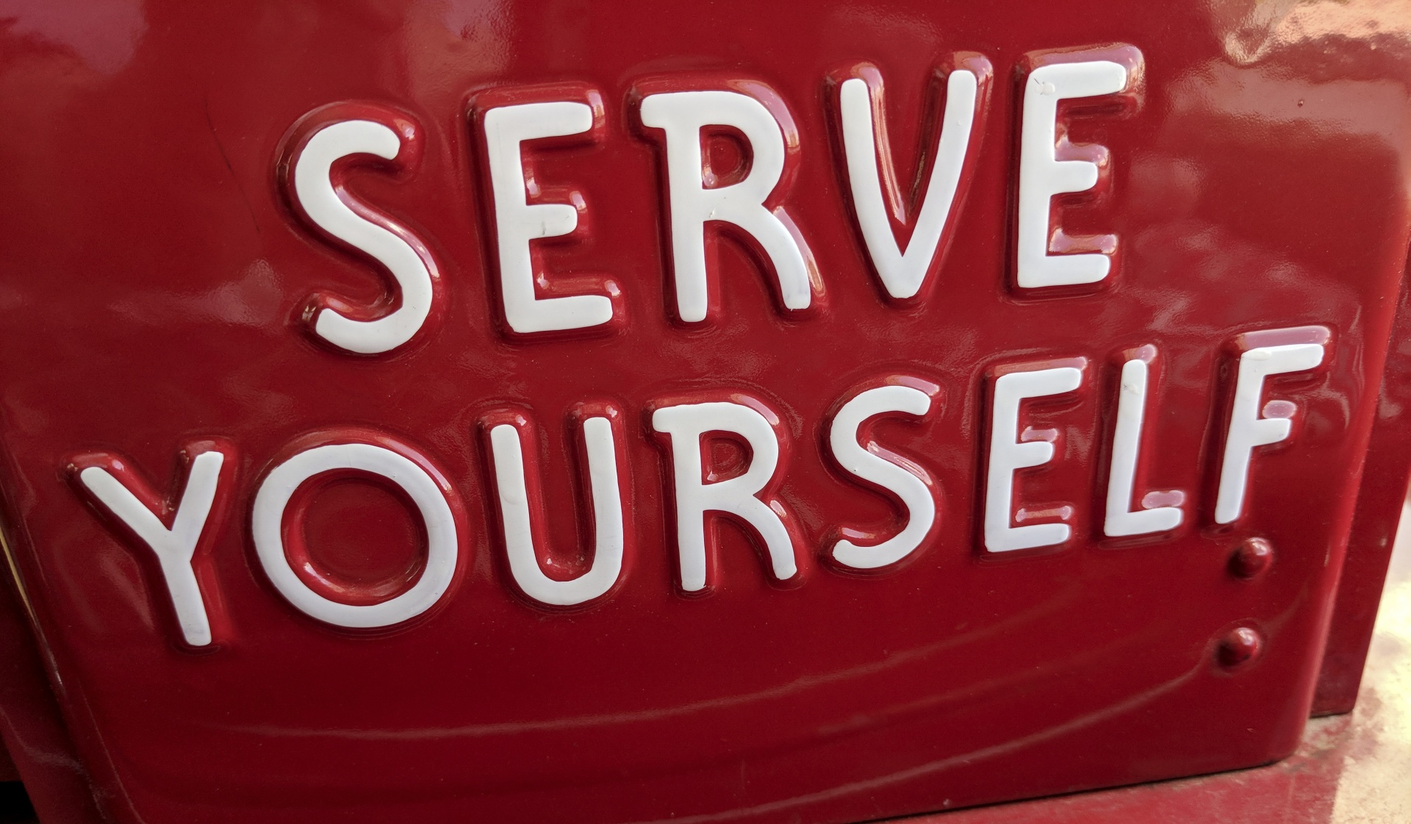
Internal Feedback (intrinsic)
Internal feedback come from yourself.
As the author, it is your responsibility to ensure your content is:
• correct
• clear
• concise
• ethical

Slide 9

External Feedback (extrinsic)
External feedback involves a response from the receiver.
External feedback comes from external source (teammate, instructors, opponent, etc.).
Attention to the channel they use (how they communicate feedback), nonverbal aspects like time (when they send it), can serve you on this and future documents.

Slide 10

The other feedback type
Hard Copy Documents and External Feedback
External Feedback in a Virtual Environment
User-Generated Feedback
Interviews
Surveys
Focus Groups

Slide 11

2. Feedback as an Opportunity
Carl Rogers, the famous humanistic psychologist, divides feedback into five categories:
1. Evaluative
2. Interpretive
3. Supportive
4. Probing
5. Understanding

Slide 12
Five types of feedback
Evaluative feedback often involves judgment of the writer and his or her ethos (or credibility).
Interpretive feedback requests confirmation or clarification of a message, and is often expressed in the form of a question.
Supportive feedback communicates encouragement in response to a message
Probing Feedback: communicates targeted requests for specific information
Understanding Feedback: communicates sympathy and empathy for the source of the message

Slide 13
Key Takeaway
Feedback may be indirect or direct, internal or external, and may be mediated electronically in many different ways.
Those offering the feedback must have an understanding of what makes a successful performance.
Feedback may be evaluative, interpretive, supportive, probing, or understanding, and it is always an opportunity for growth.

Slide 14
Activity
Find a blog or online article with comments posted after the document. Choose one example of feedback from the comments and share it with your classmates. Note any trends or themes that present themselves as you explore the comments.

Slide 15

Q&A

